Slide 1
Categories
We don’t remember everything.
We take specific information and make it more general.
Categories – represent specific knowledge in a general way.

Slide 2
Categories
Why do we create categories?
  Predictability
  Cognitive Misers (Economy of Representation)

Slide 3
Categories
How do we create them? (Theories)
  Feature Comparison
  Prototypes
  Exemplars

Slide 4
Feature Comparison
What are all the features of a game?
What are all the features of a dog?

Slide 5
The Feature Comparison Model
Information is stored in memory as a list of necessary features for that category.

Slide 6

The Feature Comparison Model
Features are either:
  DEFINING : Necessary
  CHARACTERISTIC: Descriptive
What are the defining features of dog/games?
What are just the characteristics of dog/games?

Slide 7
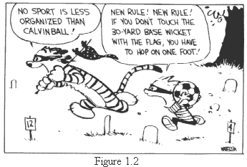
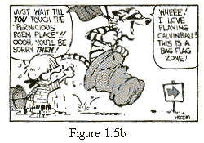
Calvinball?

Slide 8
Feature Comparison
So how do I decide if Calvinball is a game?
Stage 1: Compare target defining features
Stage 2: Compare characteristic features

Slide 9
Feature Comparison
Research using the sentence verification technique
Typicality Effect: People reach decisions faster for features that are typical
  Dogs have tails.
  Dogs have skin.

Slide 10
Problems
Doesn’t tell us how members of categories are related to one another
Requires clear-cut boundaries

Slide 11
Prototype Models
Prototypes: Idealized version of a concept
  Abstract
  No list of necessary defining features
  Fuzzy boundaries

Slide 12
Prototype Models
Compare new instance to prototype:
  Match = member
  Mismatch = not a member

Slide 13
Prototype Models
Things aren’t all equal though:
  Hierarchical Structure
  Games?
  Dogs?
This effect is called = prototypicality.

Slide 14
Prototype Models
How does this hierarchical structure work?
3 levels
  Superordinate: most abstract (animal)
  Basic Level: usually the prototype (dog)
  Subordinate: most concrete (German Sheppard)

Slide 15
Prototype Models
Basic level names have a special status
Used to identify objects
Members of basic level categories have attributes in common

Slide 16
Prototype Models
So, how do we know these three levels are separate?
Brains!
  Superordinate: pre-frontal cortex
  Subordinate: parietal/occipital lobe

Slide 17
Prototype Models
No defining characteristics shared by all members
Prototypes have many overlapping features w/ other category members
  This answers how they are related to each other.

Slide 18
Prototype Models
Good:
  Parsimonious: Shows how we reduce large amount of info
Bad:
  Categories are fuzzy
  Doesn’t show how we store specific details for category members

Slide 19
Exemplar Models
Exemplars: specific examples of a concept
  Then how much does my exemplar match this new thing?
Stored example can be a mix of different experiences.

Slide 20
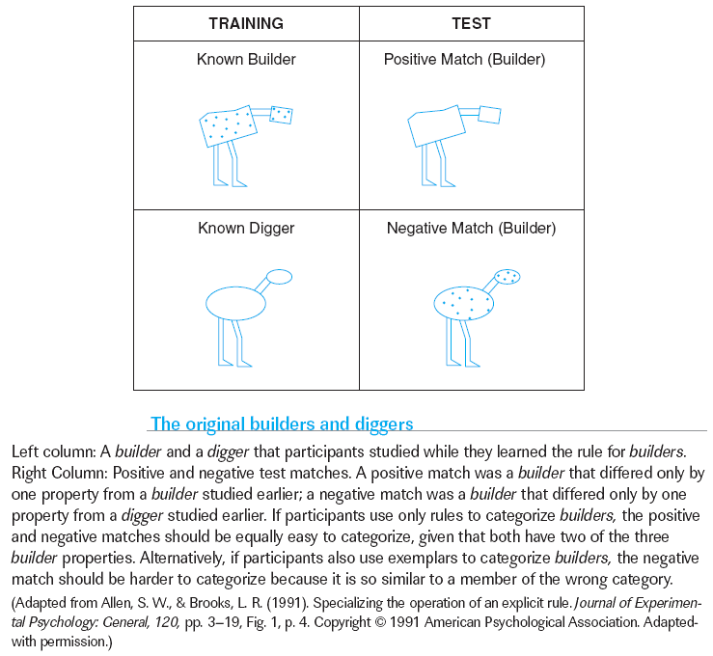
Exemplars and Rules
Chapter 4

Slide 21
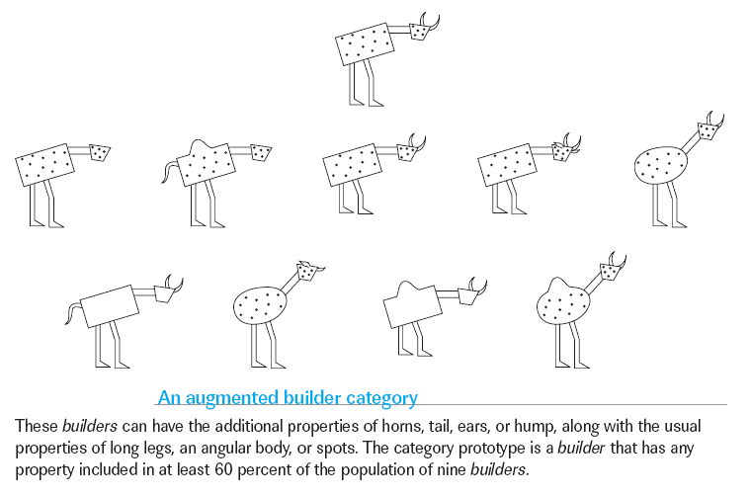
Prototypes and Typicality
Chapter 4

Slide 22
Which one which one?
Different categories may need different strategies to work with them
Exemplars may be more effective for storing small categories
Prototypes for larger, more complex categories

Slide 23
Network Models
Network models emphasize the connections between items

Slide 24
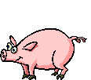

Parallel Distributed Processing
MCClelland & Rumelhart (1981)
Two other names for the PDP model…
  Connectionism and neural networks

Slide 25
Network Models
Node
Output
Layer
Link
.35
Hidden
Layer
.08
Weight
Input Layer

Slide 26
Network Models
Bird
Dog
Output
Layer
Hidden
Layer
Feathers
Fur
Wings
Tail
Beak
Input Layer

Slide 27
Schemas & Scripts
Aka special types of categories.

Slide 28
Schemas
General knowledge about something
A framework for understanding
A type of heuristic/mental model

Slide 29
Schemas
Top-down or bottom-up?
Helps organize info, direct attention, & fill in the gaps
Means that we don’t have to supply all info

Slide 30
The procedure is actually quite simple. First arrange items into different groups. Of course one pile may be sufficient depending on how much there is to do. If you have to go somewhere else due to lack of facilities, that is the next step; otherwise, you are pretty well set. It is important not to overdo things. That is, it is better to do too few things at once than too many. In the short run, this may not seem important but complications can easily arise. A mistake can be expensive as well. At first, the whole procedure will seem complicated. Soon, however, it will become just another facet of life. It is difficult to foresee any end to necessity for this task in the immediate future, but then, one can never tell. After the procedure is completed one arranges the material into different groups again. Then they can be put into their proper places. Eventually they will be used once more and the whole cycle will then have to be repeated. However, that is part of life. (Bradsford & Johnson, 1972)

Slide 31
Scripts
General knowledge about how to do something (series of steps/operations)
Special subset of schemas

Slide 32
Scripts (Schank & Abelson, 1977)
John went to a restaurant. He asked for a hamburger. He paid the check and left.
John went to a restaurant. He asked the waiter for a hamburger. He paid the check and left.
John went to a restaurant. He ordered a Big Mac. He paid for it and then ate it while driving to work.

Slide 33
John was feeling hungry as he entered the restaurant. He settled himself at a table and noticed that the waiter was nearby. Suddenly, however, he realized that he’d forgotten his reading glasses.
Frames (a.k.a., slots): details about specific events w/in a script
Default value: most common/typical value that occupies a slots

